Slide 1
A Breath of Fresh Air with ES, DDD and CQRS
Tackling Complexity²
Notes:
Welcome everybody. I’m honored to see so many of you here –

Slide 2
Today’s Talk
The topics...
...are about
Our Context
What is DDD and ES?
Looking at system’s properties
Where are we coming from? To where?
The fundamental principles
How did we fare?
Notes:
Let’s walk through the talk.
We’ll go through – topics. (1, 2, 3)
The topics will answer the questions – questions.

Slide 3
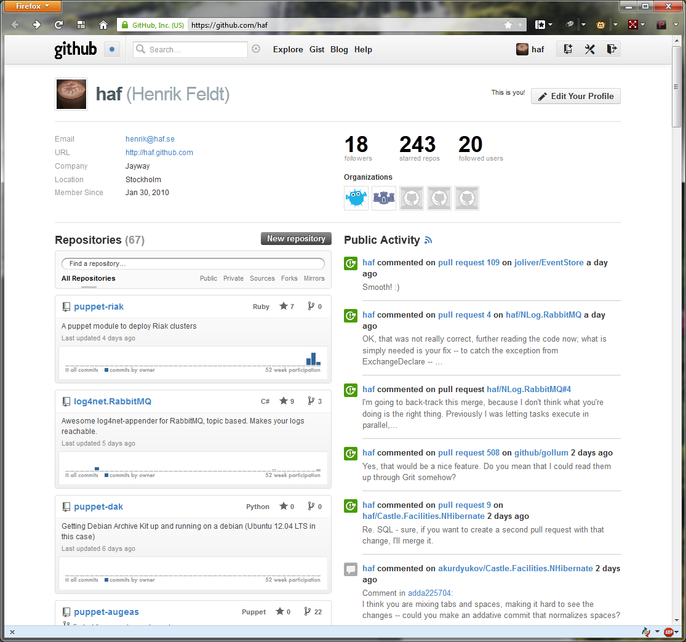
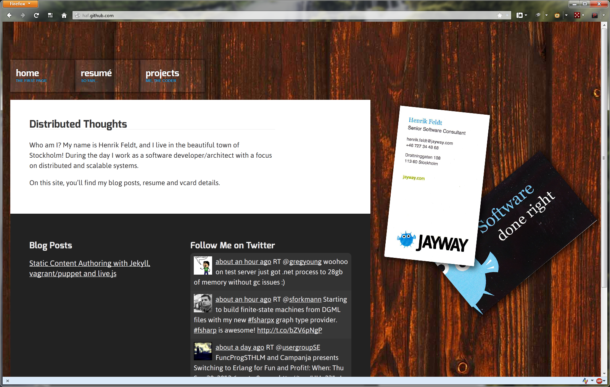
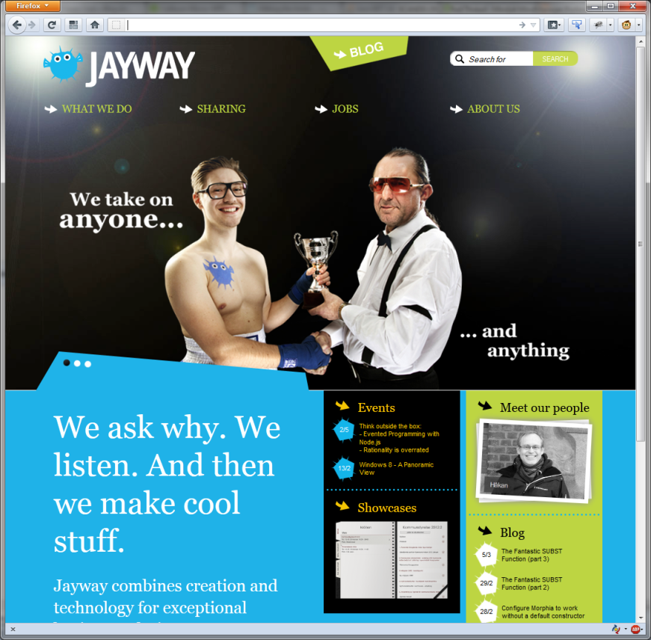
About Me
@henrikfeldt
haf.github.com
Notes:
So who am I to talk about this?
Work at Jayway, a company focusing on sharing knowledge
We’re a consulting company
Enjoy github ... [NEXT]

Slide 4
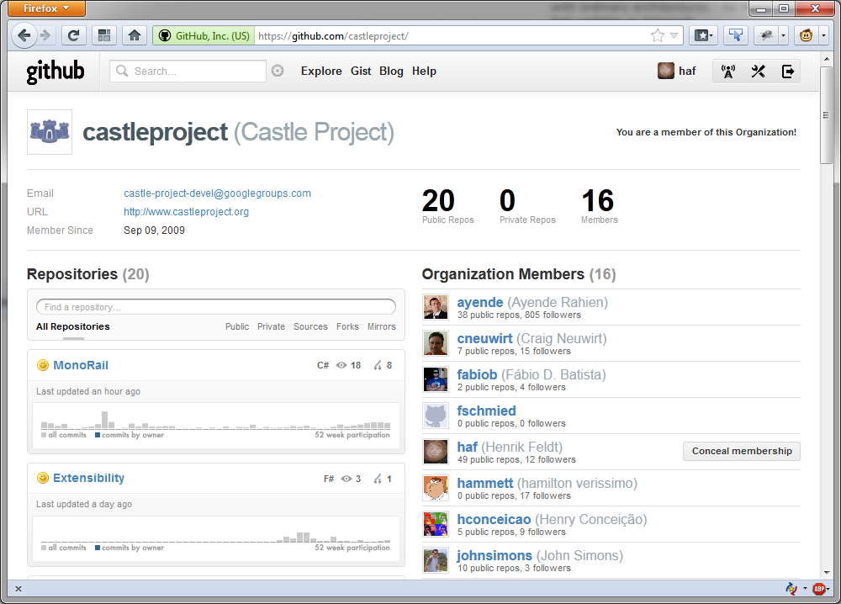
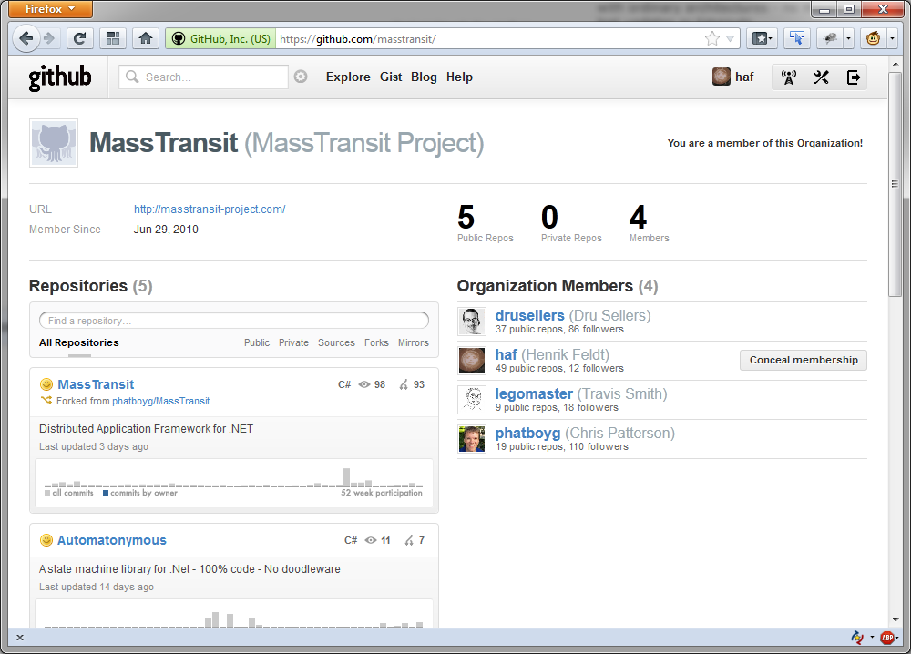
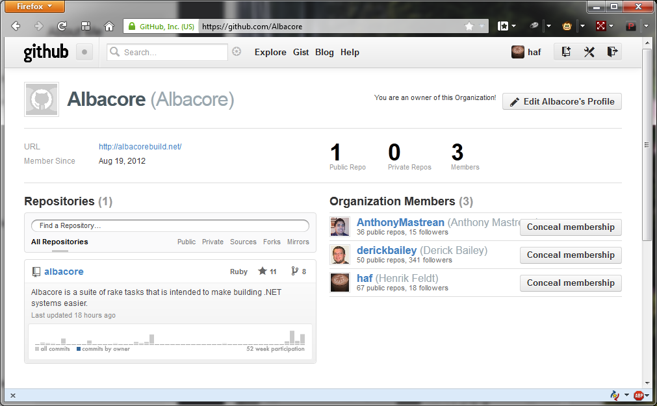
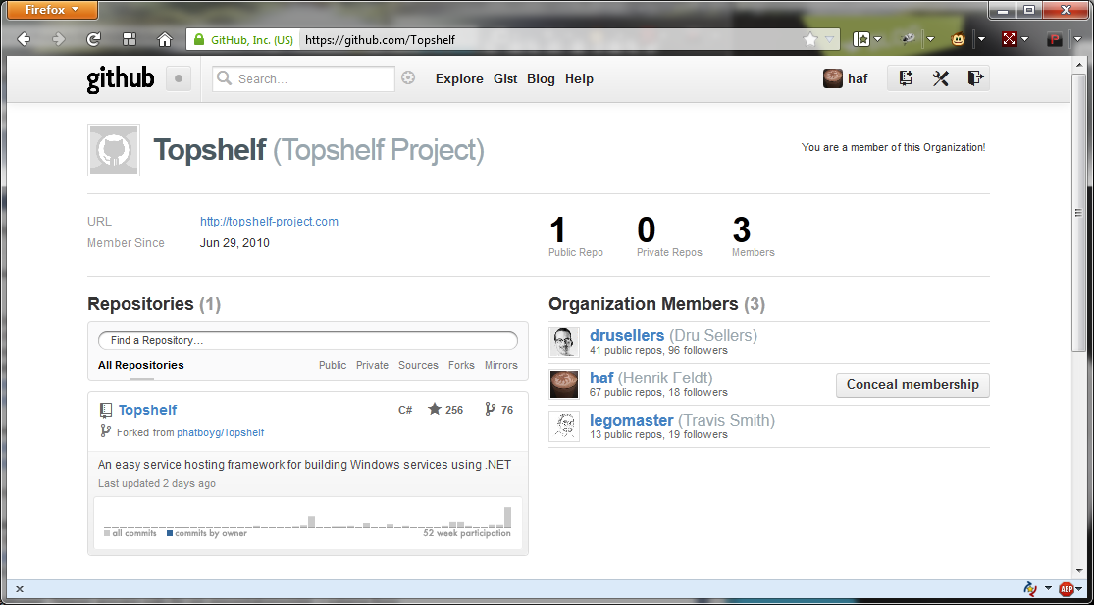
My Affiliations

Slide 5
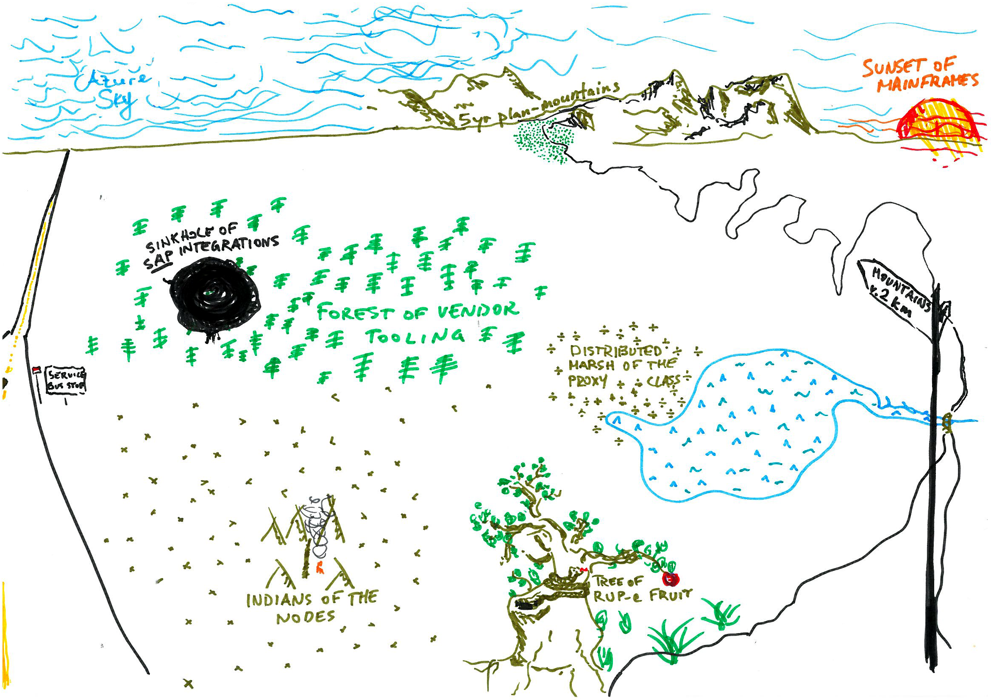
Notes:
More and more time spent on managing existing code, less on writing new, even with new tools.
That’s the way it is across industry today.
New features take longer and longer.
Software Quality hard to keep up.
You might be the lead of a team,
Or a developer interested,
Or a coding architect – what you need is a way to think about software.

Slide 6
How hard do you think it is to apply DDD and Event Sourcing?

Slide 7
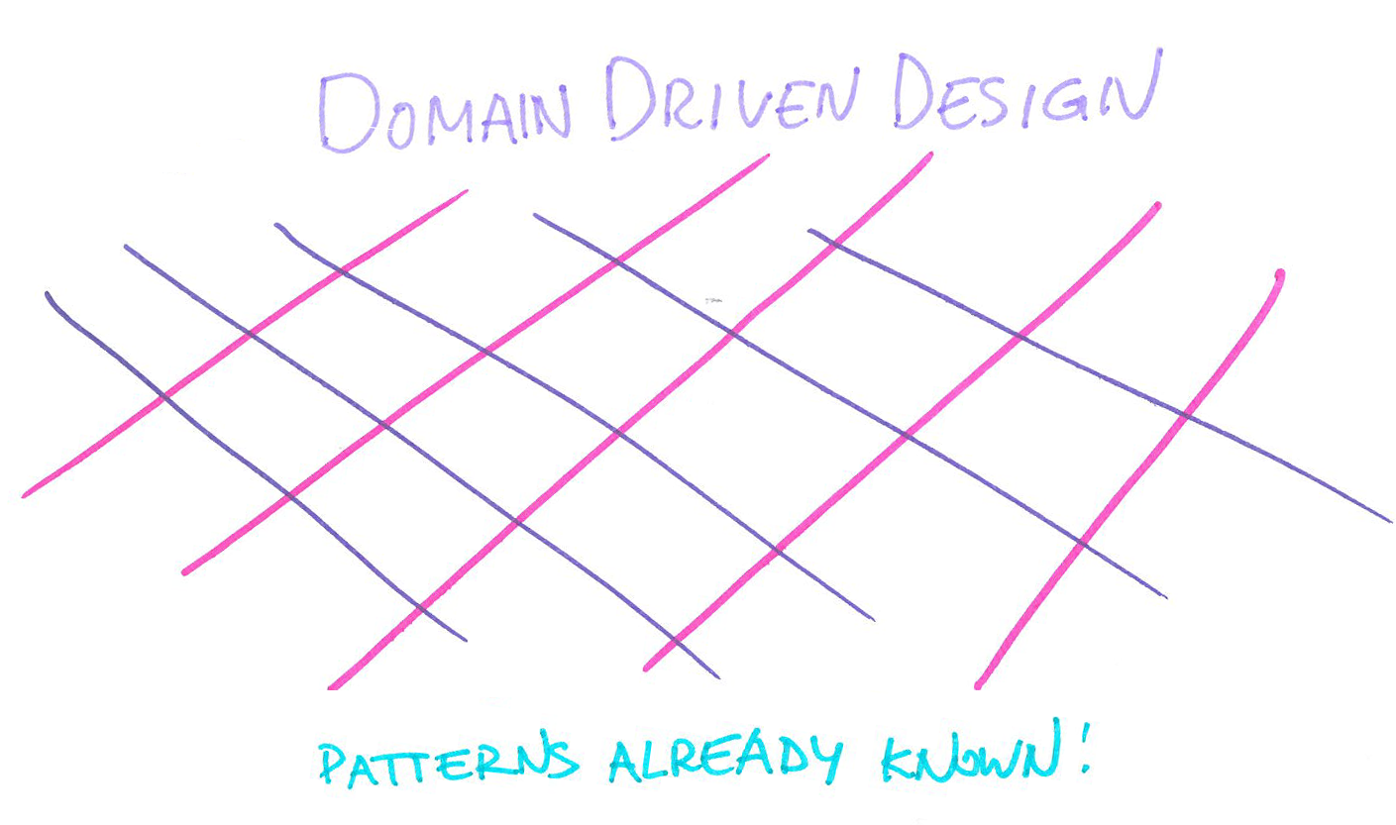
Notes:
In fact, DDD is mostly a collection of patterns already known.
Hard part about it, is that it’s never done; so you never feel the relief of marking DDD complete.
We can qualify the statement further; doing any sort of domain modeling is hard by nature, but DDD aim to make it easier to reason about it.
In fact, the sort of DDD we will talk about...[NEXT]

Slide 8
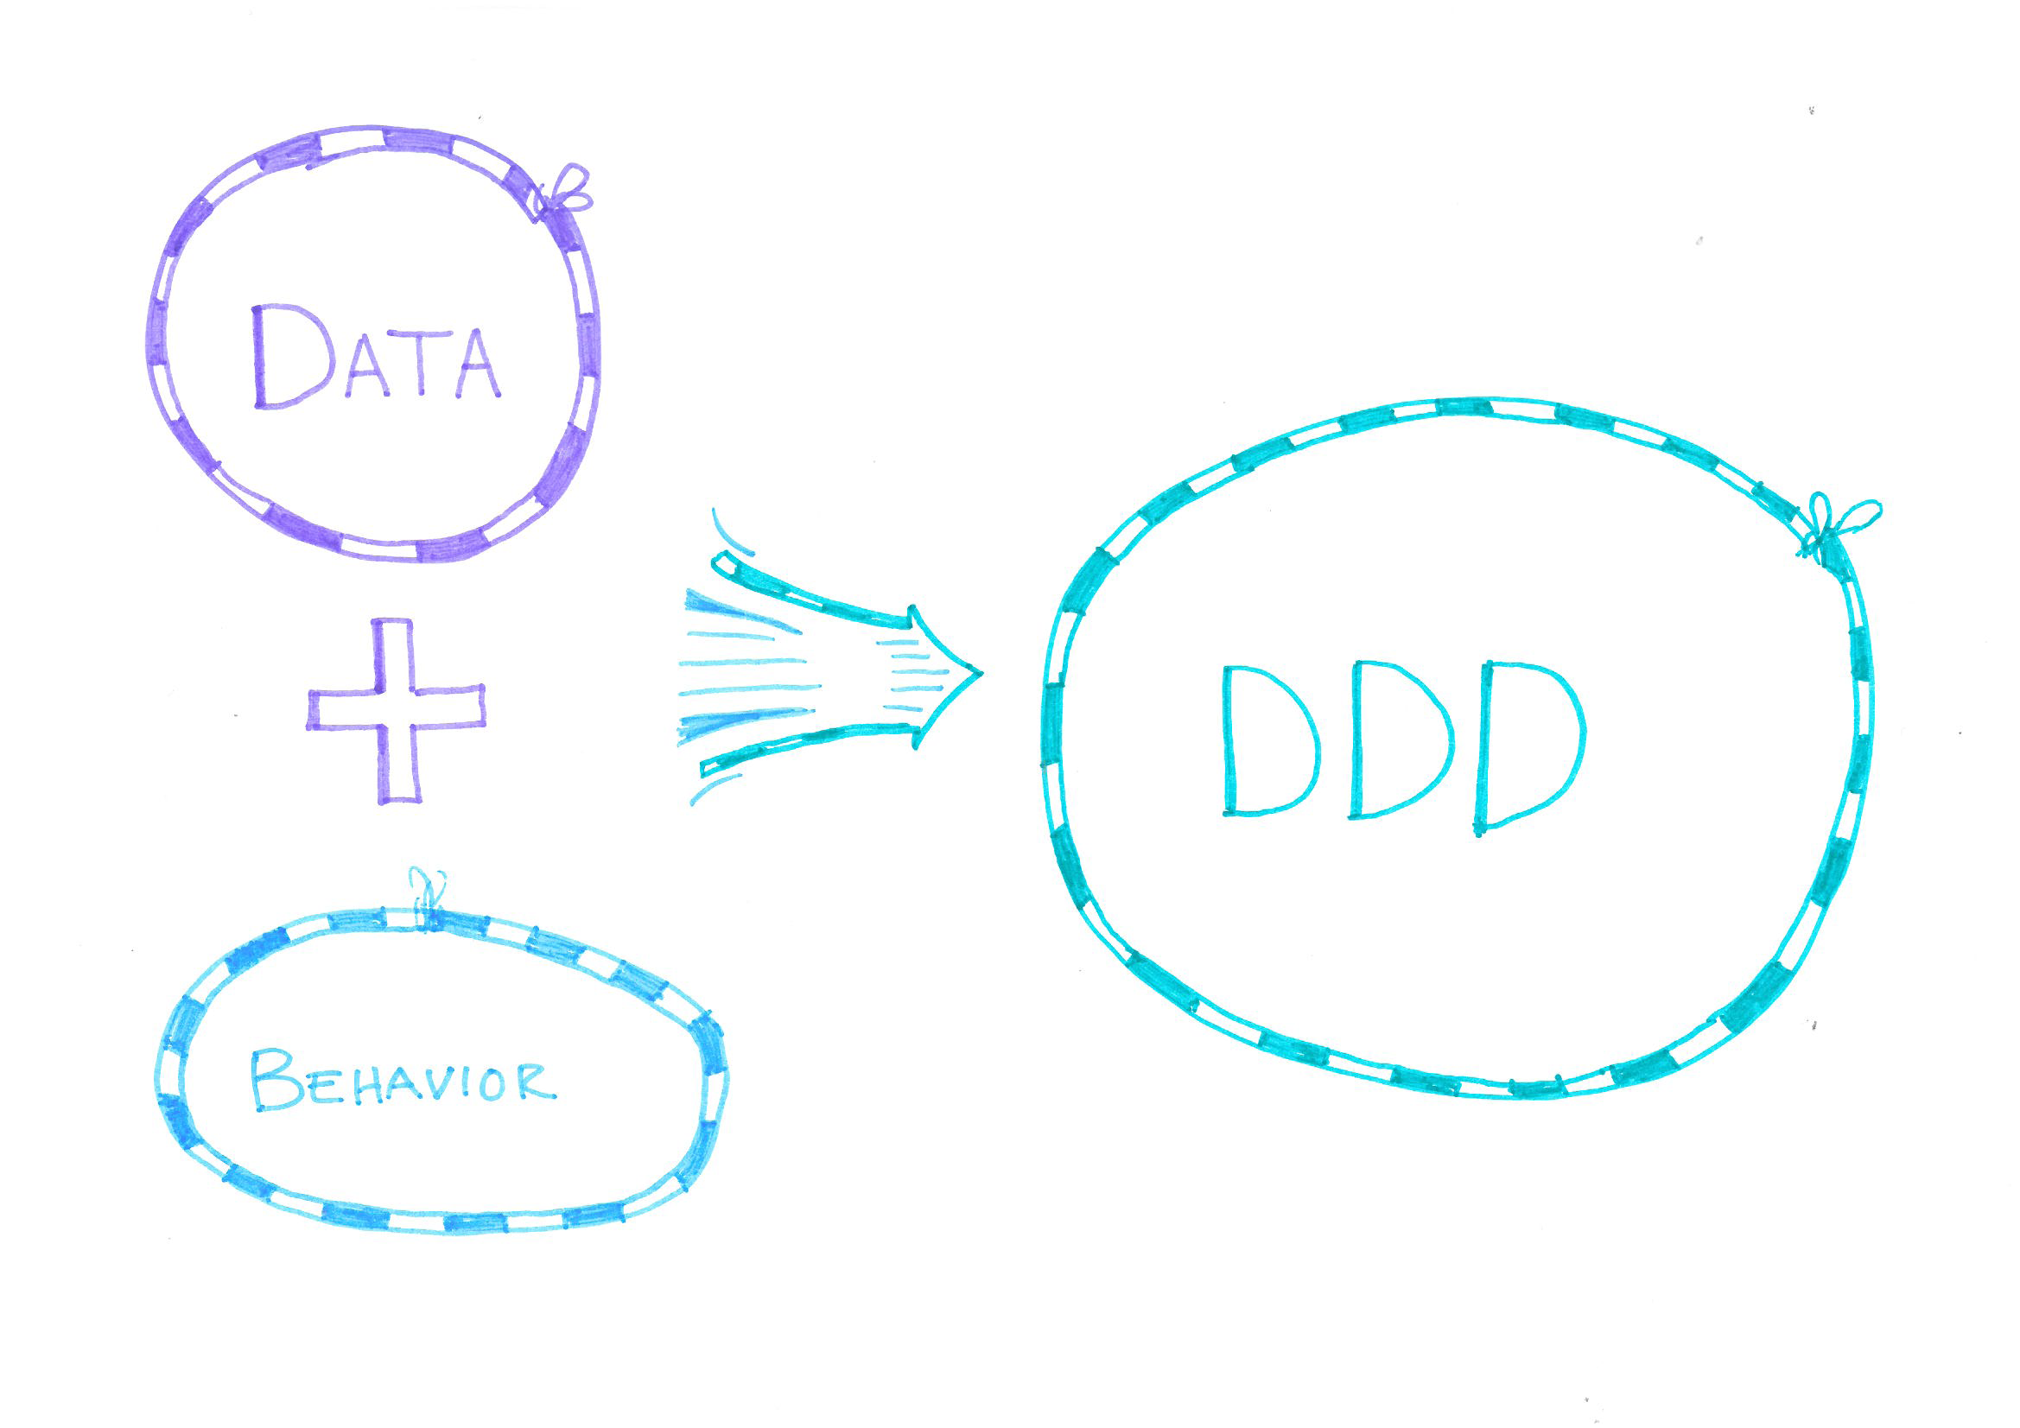
Notes:
Domain Driven Design & Modelling,
when you have your historical data and behaviour together.
You act based on the historical events that you have seen; behaviour depends on what has been done before.
The historical events is what state you have after having seen domain invocations.
DDD isn’t meant to stand alone though...
Fits in.

Slide 9
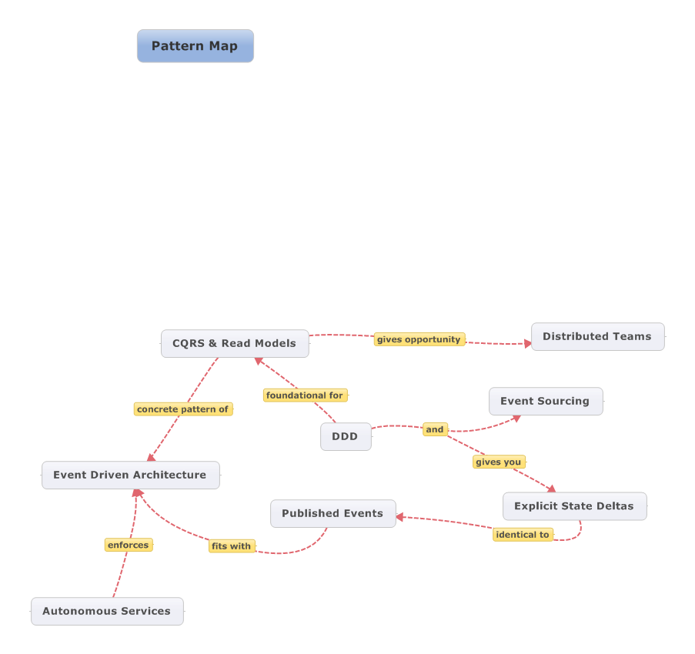
Notes:
In the Grand Scheme of Things, this is how it fits together.
DDD in middle.
Message/event driven architecture all around.
Easy reasoning with Event Sourcing and Explicit State Deltas
Together it is easy to create autonomous services
Makes it cheaper to develop, because each service with worth less, and can be revved faster

Slide 10
Tour of the concepts
Command Handler
Repository
Aggregate, Events, Logic
Persister of Events
Publisher of Events
N x Event Listener
User wants happening
User sees happening
A pipeline
Notes:
Let’s go through the concepts needed to understand this sort of architecture.
Initially

Slide 11
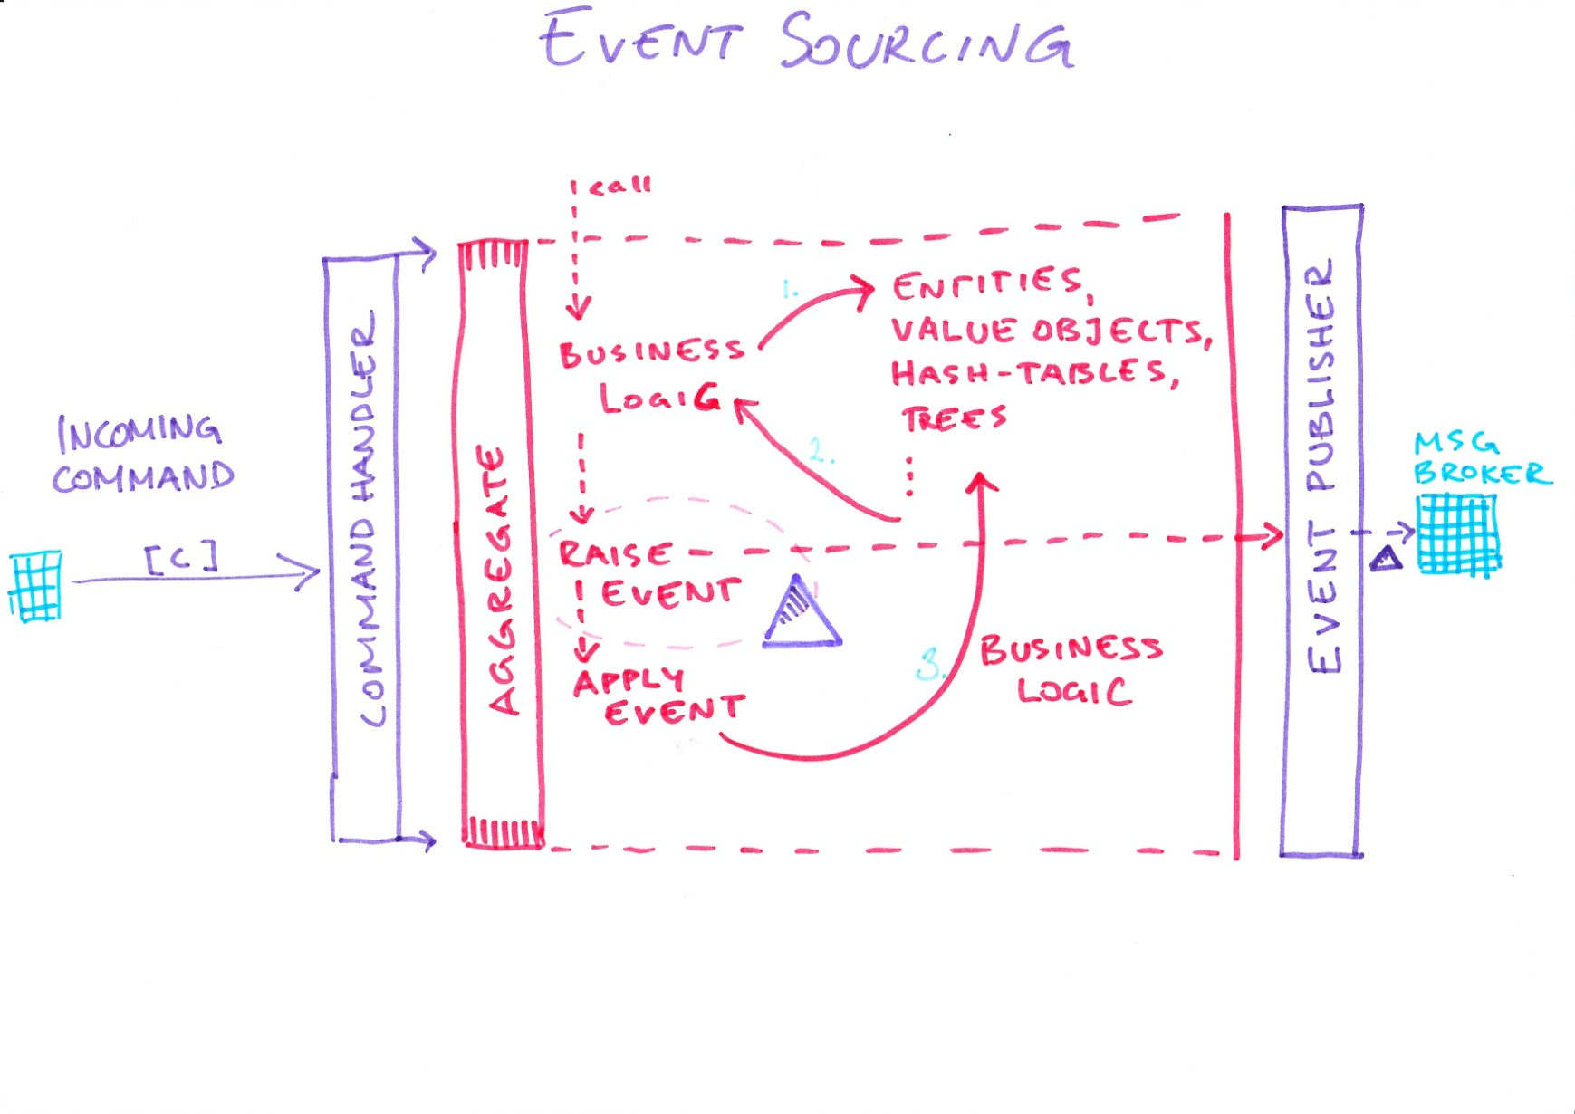
Event Sourcing?
Notes:
What is Event Sourcing?
1-click: before command is ’accepted’
2-click: full picture; apply command, publish event.
[Linger a bit on the slide]

Slide 12
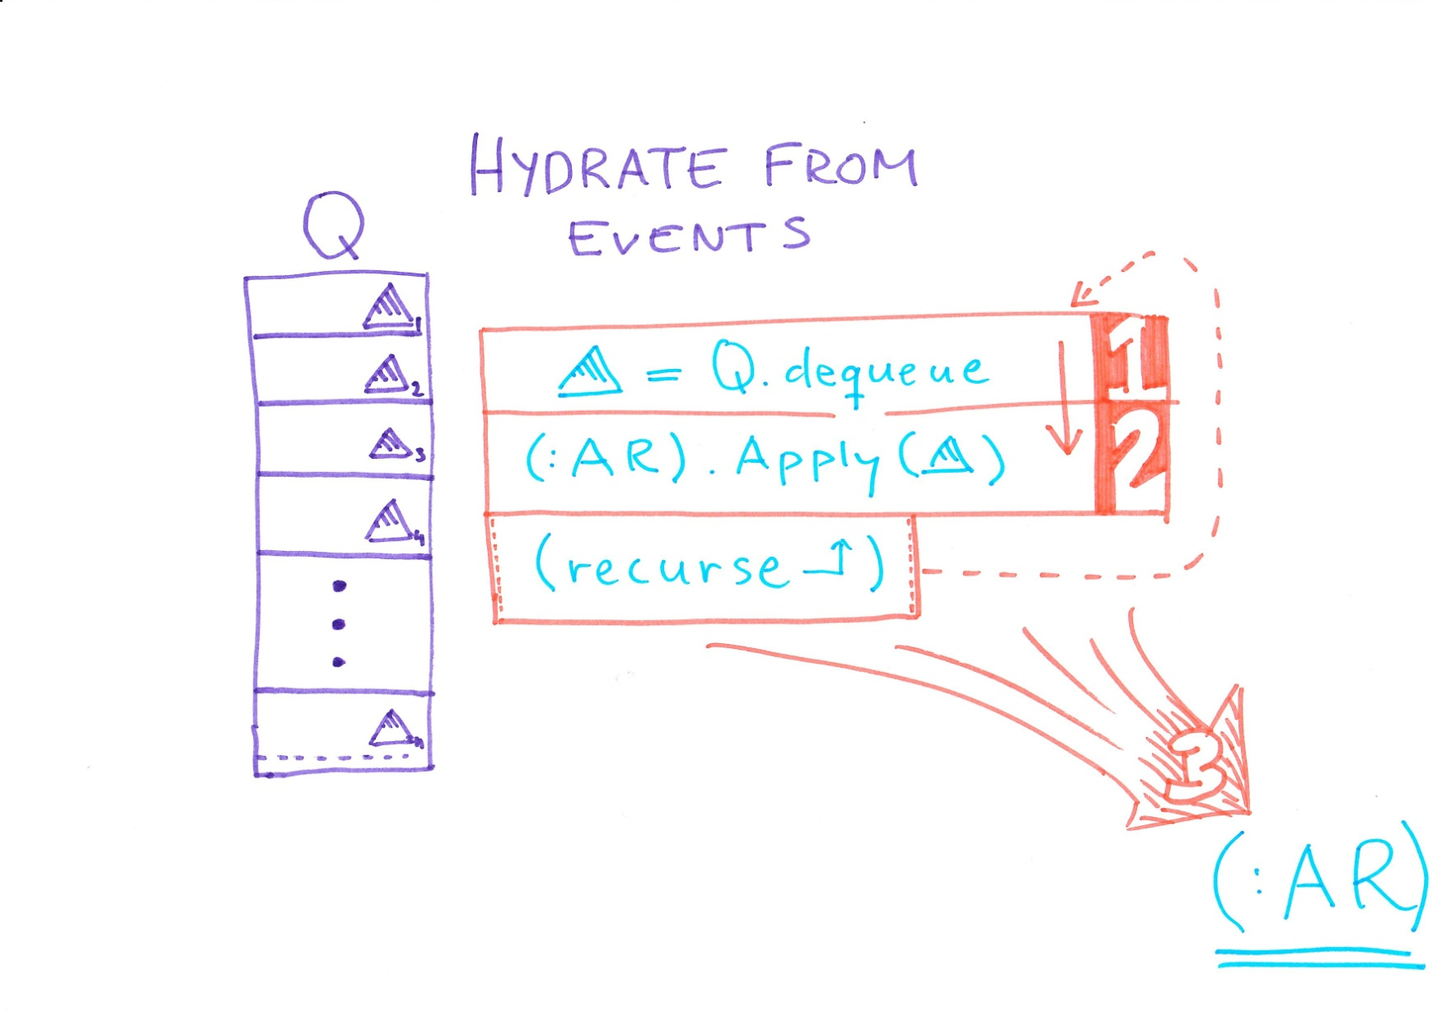
Event Sourcing?
Notes:
When reading back your entity,
Apply all events onto it.

Slide 13
Domain Object Invariants
Pure Methods
No stochastic methods (no randomness)
Message reordering OK!
Notes:
By having pure methods we can try to apply a command multiple times to an aggregate without world state changing; this is imperative for repeatability.
No Random.Next(), because then we can’t reliable reproduce state!
Having message reordering is OK, because we should be able to operate with multiple concurrent users, but we order messages from a single producer by sequence ids if we can. Otherwise, we create the AR with enough invariants to force infrastructure to defer commands that aren’t working.

Slide 14

Messaging Concepts & Failure
Out of Order possible
Reliable Messaging
At Least Once Delivery
Notes:
There are some concepts that become intimately familiar, namely;
* OOM
* Reliable Messaging * At-Least-Once
Starting at the top, we have in coming command

Slide 15
...
C2
C3
C5
C4
C6
...
C5: Retry Later
1. Out of Order messages
Notes:
Out of Order messages can simply be retried; they will either work, because they are based on an aggregate version that is valid to apply such a command on.
Or they will fail; in the meantime the previously sent commands can be tried – as such, the latter commands are re-consumed on top of results of the state deltas resulting from the previously sent commands.

Slide 16
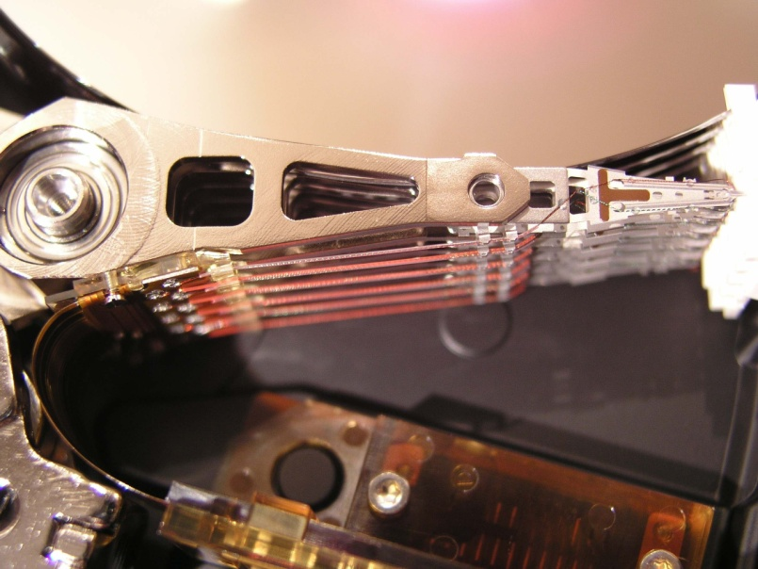
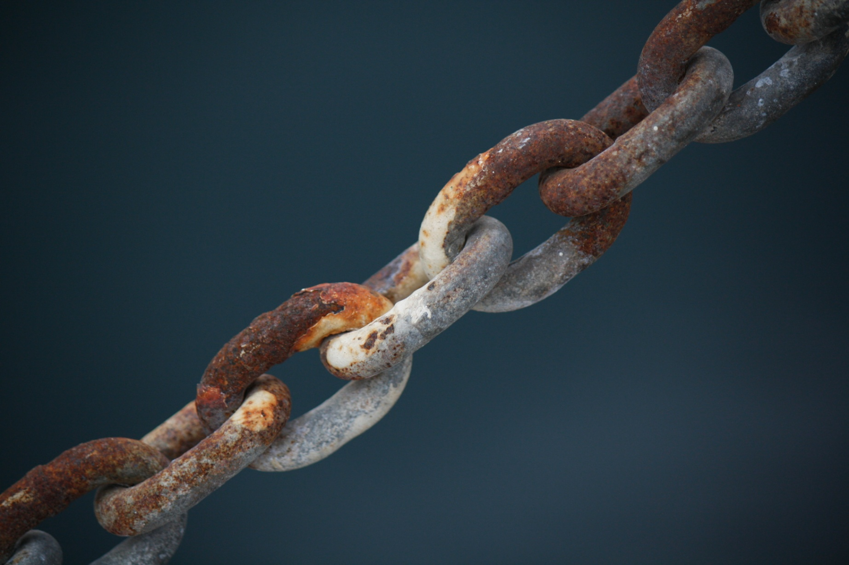
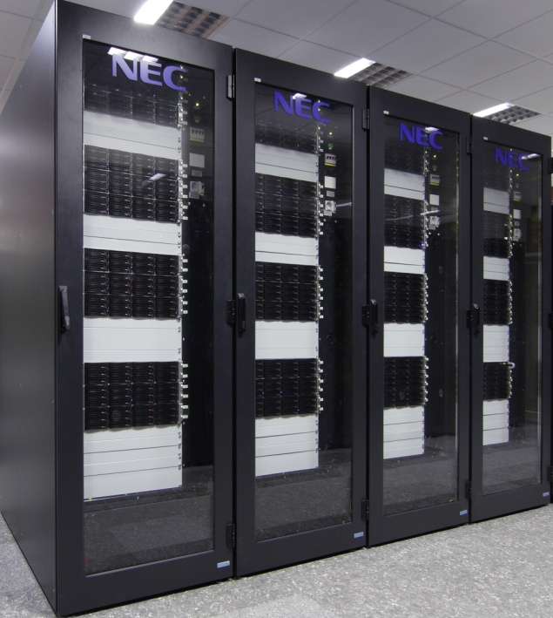
2. Reliable Messaging
Notes:
We should never ever lose messages!
Messages should be either persisted to a cluster of machines or to disk.
When persisting to disk, we assume that the disk is part of a RAID array that doesn’t fail completely during the lifetime of the message.
When persisting to a cluster memory, the assumption is that at least two computers in the cluster are on different power supplies and that at least one of them will be up during the lifetime of the message.
You need to analyze your non-functional requirements and environment to see what failures are most likely to occur in your environment.
http://www.sxc.hu/photo/1381655 <- links
http://www.sxc.hu/photo/238476 <- harddrive
http://en.wikipedia.org/wiki/File:Nec-cluster.jpg by http://commons.wikimedia.org/wiki/User:Hindermath

Slide 17

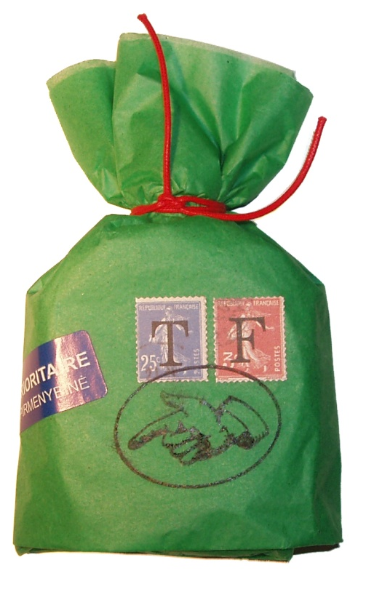
3. At Least Once Delivery
Notes:
At least once delivery, means that you might get a unique message more
than one time, so you have to be prepared for that.
That’s an overview of messaging. What about event sourcing? [NEXT]

Slide 18
Failure Scenarios
Command Handler
Repository
Aggregate
Persister
Publisher
N x Event Listener
Notes:
Let’s have a look at the different failure scenarios that might occur in the pipeline and how to deal with them.
For example, we might have a failure... [NEXT]

Slide 19
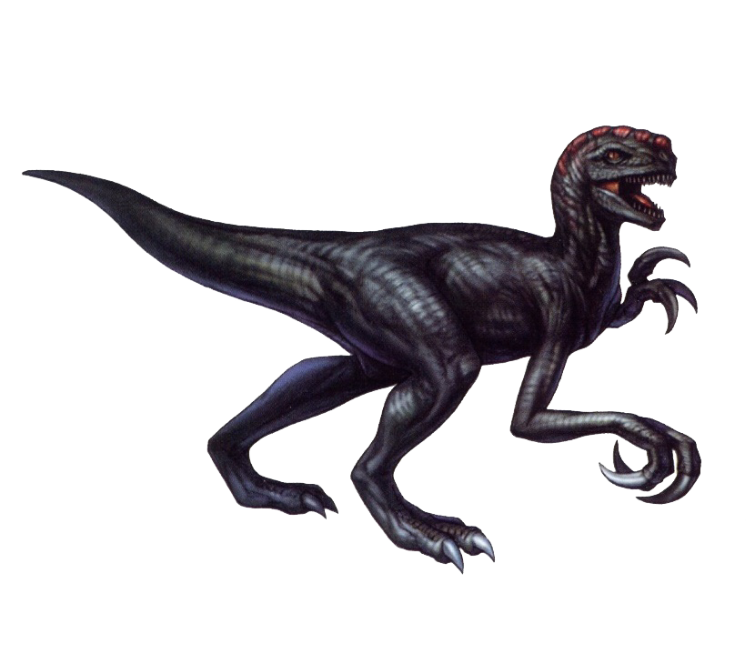
Message Flow
Command Handler
Repository
Aggregate
Persister
Publisher
N x Event Listener
Notes:
...during execution of the command handler!
What happens if the Command Handler blows up? We put the message in a Poison Queue for manual inspection.
Why might it?
Serialization error (corruption)
Computer shuts down
It turns out...

Slide 20
Message Flow
Repository
Aggregate
Persister
Publisher
N x Event Listener
Notes:
...that we’re no worse, no better off. We have the CMD in Q.
If we have heartbeats, an online worker takes over from the same queue (competing consumers).
...
So what happens if the Repository fails?

Slide 21
Message Flow
Repository
Aggregate
Persister
Publisher
N x Event Listener
Notes:
Why might it?
Event Store temporarily unavailable due to
Harddrive Failure
Failed Network Card
In this case, we just keep retrying to retrying until the event store is available again;
Assume operations team know about failure.

Slide 22
Message Flow
Aggregate
Persister
Publisher
N x Event Listener
Notes:
...that we’re no worse, no better off. We have the CMD in Q.
If we have heartbeats, an online worker takes over from the same queue (competing consumers).
[PAUSE]
So what happens if business logic ... [NEXT] blows up?

Slide 23
Message Flow
Aggregate
Persister
Publisher
N x Event Listener
Notes:
Retry later; we might have gotten message out of order.
Otherwise, move to poison queue and do better testing!

Slide 24
Message Flow
Persister
Publisher
N x Event Listener
Notes:
So we can handle (to some extent) our business logic being wrong. Good.
What about the persister?

Slide 25
Message Flow
Publisher
N x Event Listener
Persister
Notes:
If the persister fails, even after retrying to reach ES:
Give up; notify operations team.
Nothing has been published, nothing has happened, because all functions are pure.

Slide 26
Message Flow
Publisher
N x Event Listener
Notes:
So the persister passes the test. Publisher?

Slide 27
Message Flow
Publisher
N x Event Listener
Notes:
The publisher’s responsibility:
* Take commit,
* publish it,
* mark it as dispatched
Let’s have a look at this piece a bit closer...

Slide 28
... → C2
C2 -> evts commit
ACK C2
C3
C3 -> evts commit
Server Down!
C3
C3 -> evts commit (duplicate!)
ACK C3
C4 → ...
At Least Once Delivery
Notes:
At least once delivery: may receive a single message multiple times.
As such, we need to make sure that we don’t perform duplicate logic.
See example -> C3 evts commited successfully, but not ACKed.
A common method for handling this, which is in use with Event Store is to save the commit with the id of the message;
Event Store enforces a UNIQUE constraint on the commit, so commits resulting from a message that was re-delivered will be silently thrown away.
The duplicate is ignored (it must have been the same result) and you ACK the message off the queue.
Then you continue consuming.[OK back to DINO!!]

Slide 29
Message Flow
N x Event Listener
Notes:
That leaves the event listeners...

Slide 30
Message Flow
N x Event Listener
Notes:
If one goes down; it will go up again; catching up on its messages. Done. [NEXT – SHOOT DINO!]

Slide 31

Notes:
Now the evil dino is full!

Slide 32
Act 3
Looking the system’s properties

Slide 33
time
13 concurrent readers + 2 writers battling it out ...
With ACID+2PC
In Wait
Prepared!
Commit!
Lazy Collection
Aggregation
Aggregation
Business Logic
Updating Read Model
With Messaging
Placing In Queue
Read from Queue
Placing In Queue
Read from Queue
Do!
Messaging: Result Visible
Transaction: Result Visible
Eventual Consistency? I need my data NOW!
Notes:
Look at this graph and think that it’s a system under load.
2PC
While we may be have a read model, with eventual consistency that isn’t up to date with what has been ’accepted’.

Slide 34
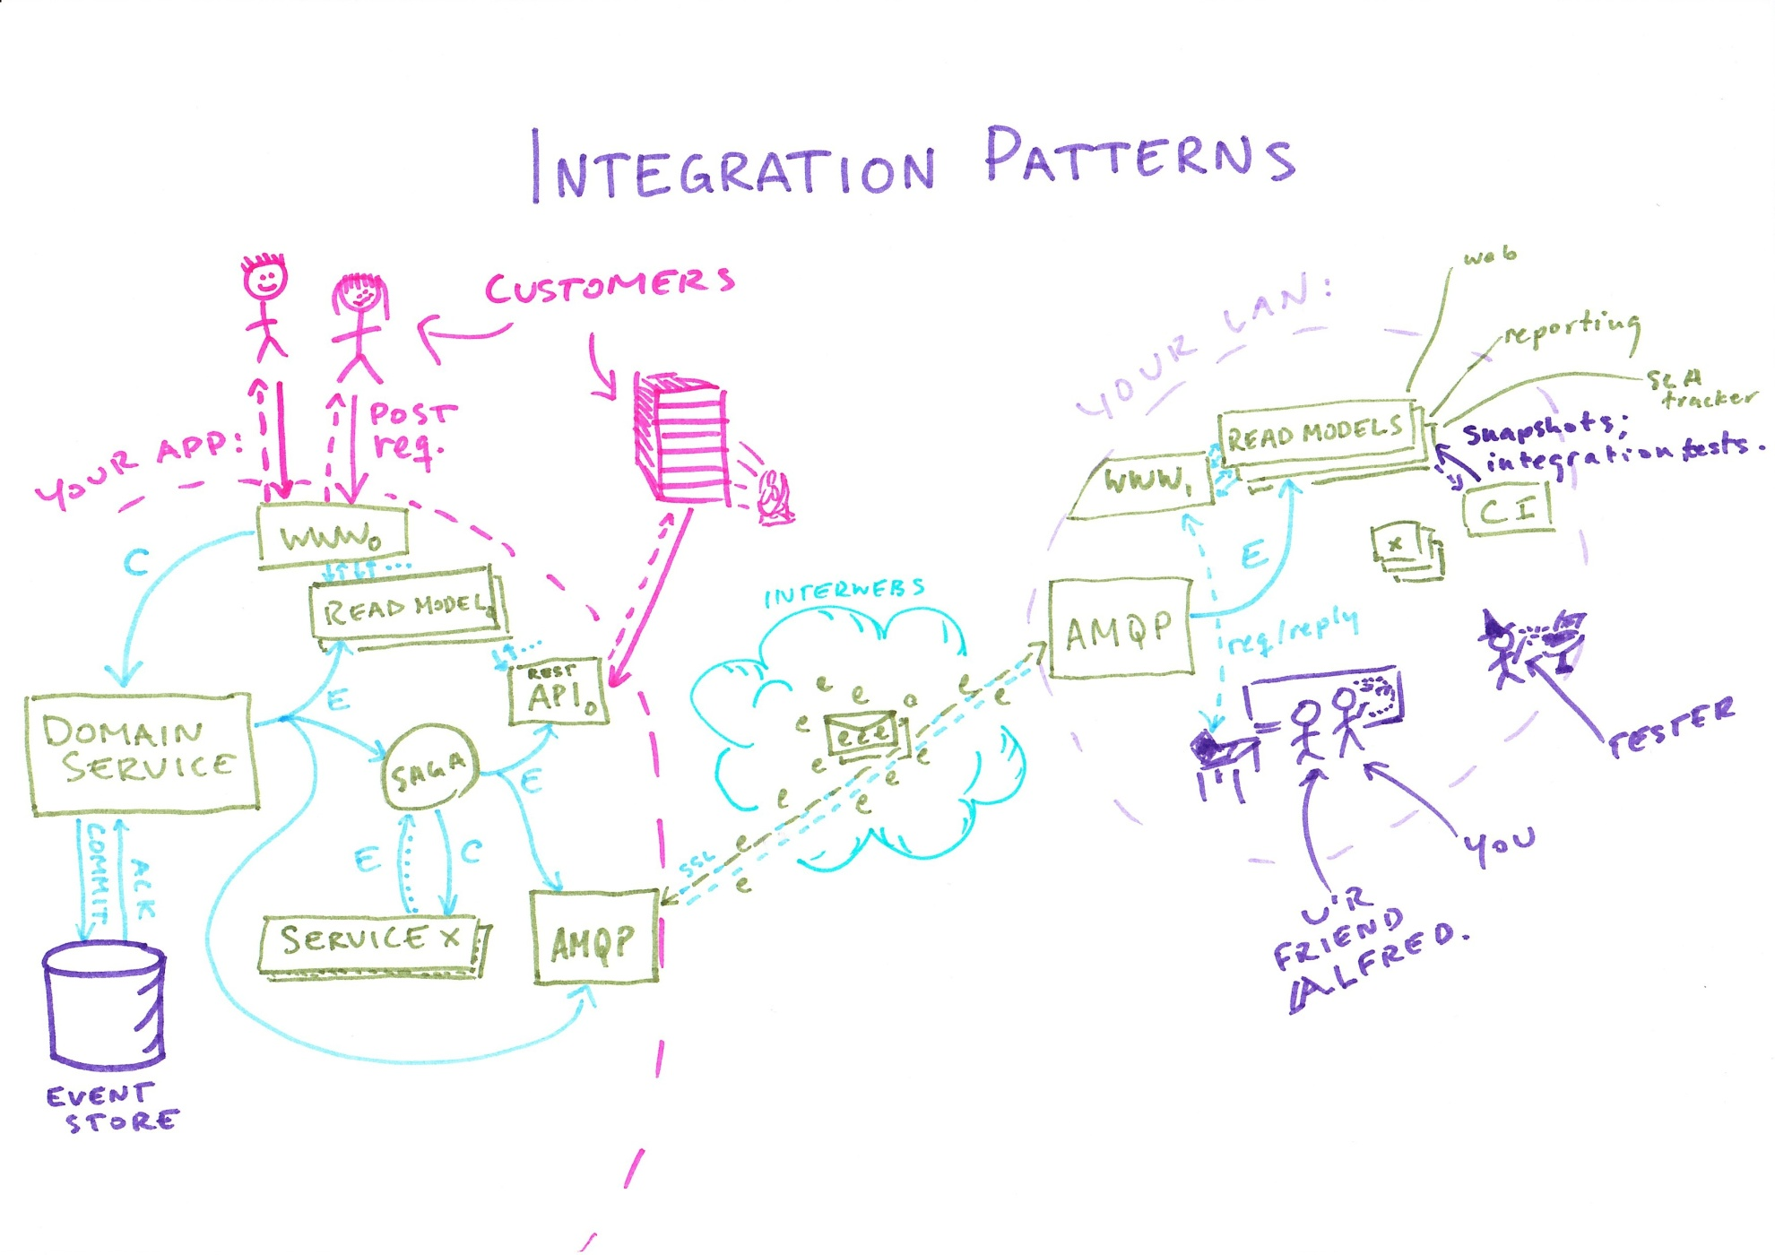
Questions?
Notes:
Production side LEFT
Your LAN, RIGHT
Integration suggestion
[PAUSE]
Customers Happy! Look at them! [POINT]
[CLICK – SHOW QUESTIONS]

Slide 35
Common questions and doubts

Slide 36
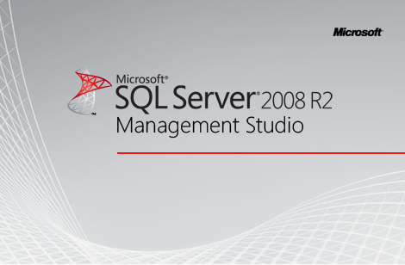
Where’s my data?
Notes:
No SQL Server Explorer anymore?!
Oh noes!
”I have always been checking the database to check whether my program inserted the correct data! Now, how do I check if the program did the right thing?”
It’s harder to visually inspect that the ”system is doing the right thing”.
[NEXT]

Slide 37

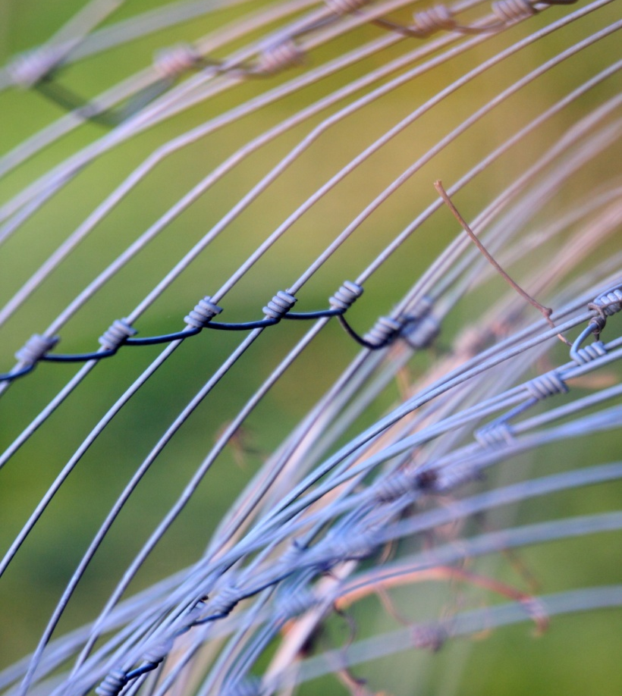
Complexity vs. Simplicity
Notes:
Complex: Latin complectī
Older word: complect
to enfold, plait or braid
Simple: From “simplex”
having a single layer or literally, one-fold,
meaning “one”
The complexity that was before with n-tier suddenly drains away.
Some of it drains into the infrastructure, as complexity in reliable messaging – but that is someone else’s headache;
I can consume an API that make concerns explicit.
Now I write my systems, with services each doing a single thing well, and only that.
Some of the complexity disappears when I can focus on domain modeling.

Slide 38

Isn’t it too much coding overhead?
Notes:
No;
What you have to do is pull yourself up by the staps all the time.
Refactor your code in your domain continuously – this avoids the long unit tests that are annoying to maintain and write.
In the end, you’ll be writing less code; and higher quality code!

Slide 39
[Subject(typeof (Customer))]
public class when_registering_new
: Handler_and_Aggregate_spec
{
static RegisterNewHandler handler;
Establish context = () =>
{
setup_repository_for<Customer>();
handler = new RegisterNewHandler(() => repo);
};
Because of = () =>
handler.Consume(a_command<RegisterNew>(new MsgImpl.RegisterNew
{
AggregateId = NewId.Next(),
CustomerName = "Henrik F",
PhoneNumber = "+46727344868",
Address = new MsgImpl.Address
{
Street = "Drottninggatan",
StreetNumber = 108,
PostalCode = "113 60",
City = "Stockholm"
}
}));
// cont... ->
// cont...
It should_yield_customer_registered = () => yieldedEvents.ShouldContain<Registered>();
It should_specify_correct_number = () =>
yieldedEvents.ShouldContain<Registered>(r =>
r.PhoneNumber.ShouldEqual("+46727344868"));
Behaves_like<Event_versions_are_greater_than_zero> should_specify_versions_above_zero;
Behaves_like<Event_versions_are_monotonically_increasing> should_specify_monotonically_increasing_versions;
Behaves_like<Events_has_non_default_aggregate_root_id> should_have_non_default_ar_ids;
}
Example
Notes:
In this case, we can read the specification like natural language!
Explain spec.
Software Development tools have never been better!
That better be the case; because customer requirements are moving on... [NEXT]

Slide 40
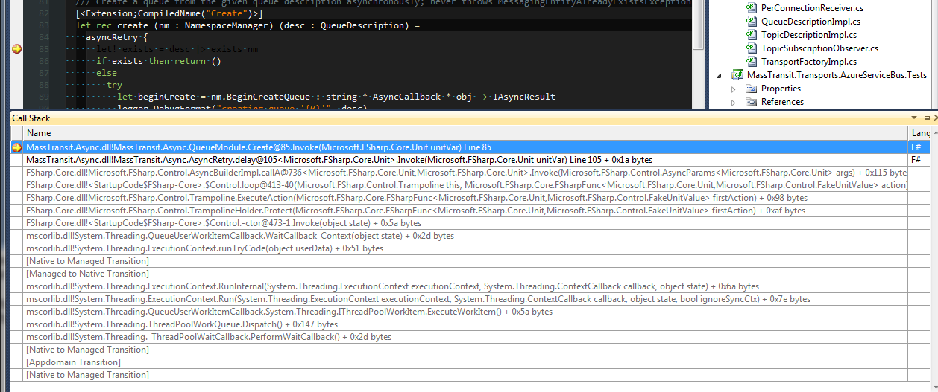
Where’s my Call Stack?
Notes:
I missed my call stack when I first started with messaging.
But I didn’t miss the complexity of the systems I am no longer building. [NEXT complexity]
http://www.sxc.hu/photo/1013935 <- call
http://www.sxc.hu/photo/1171741 <- stack

Slide 41
Application_Start:
var web = ServiceBusFactory.New(sbc => sbc.ReceiveFrom("loopback://localhost/mywebapp”));
Simplest Possible Thing!
Notes:
* Keep the queues in memory while developing
* Use the async features of C# 5
* Use the async features of F#
* Write awesome code!
* Have an awesome logging framework! Ask me afterwards what I would use!

Slide 42

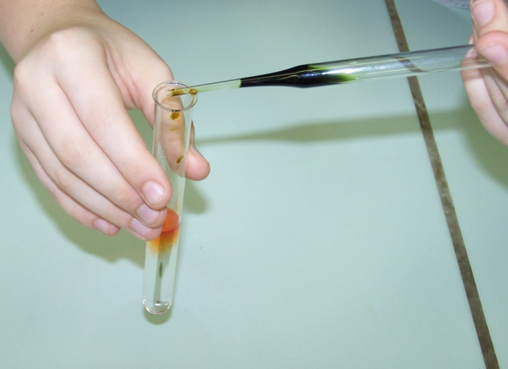
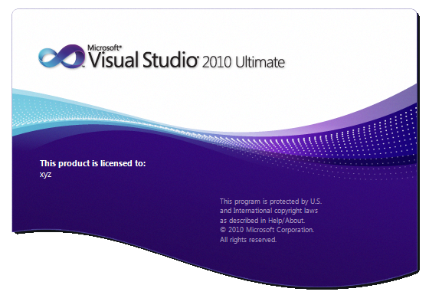
Enforces TDD
Notes:
http://www.sxc.hu/photo/1054746 <- tubes
http://www.sxc.hu/photo/1382399 <- car

Slide 43
Summary
Consistency
Availability
Reliability
A better way to build software
Notes:
So to summarize,

Slide 44
Consistency
Optimistic Concurrency
Makes Concurrency Explicit

Slide 45
Availability
Occasionally Connected Clients
Push-Based
Less Runtime and Temporal Coupling

Slide 46
Reliability
Queues
Autonomous Services
Decoupled Architecture
Semantic Merging

Slide 47
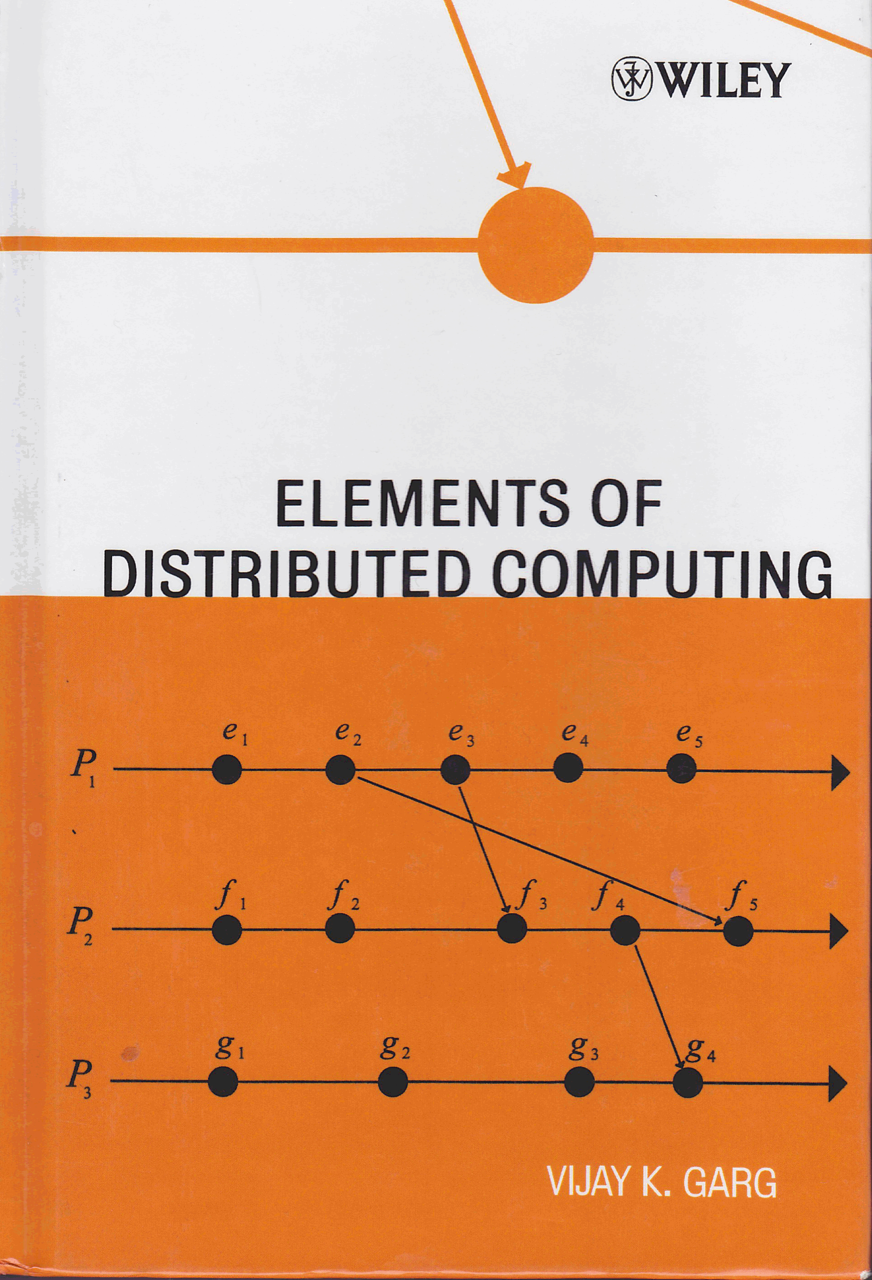
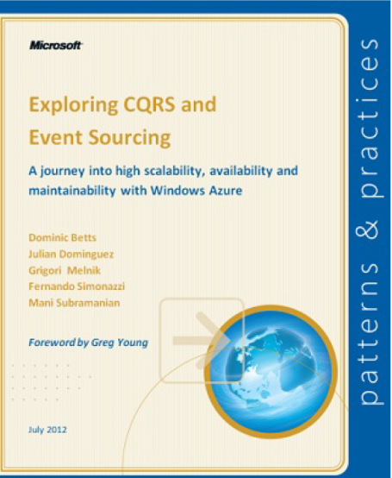
Thank you!
@henrikfeldt – Follow!
henrik.feldt@jayway.com
Keep in touch!
Resources
https://github.com/haf/Documently
http://cqrsjourney.github.com/
http://cloud.github.com/downloads/slashdotdash/cqrs-journey-pdf/mspnp-cqrs-journey.pdf
Notes:
I do consulting – do keep in touch! ;)

Slide 48
The End

Slide 49
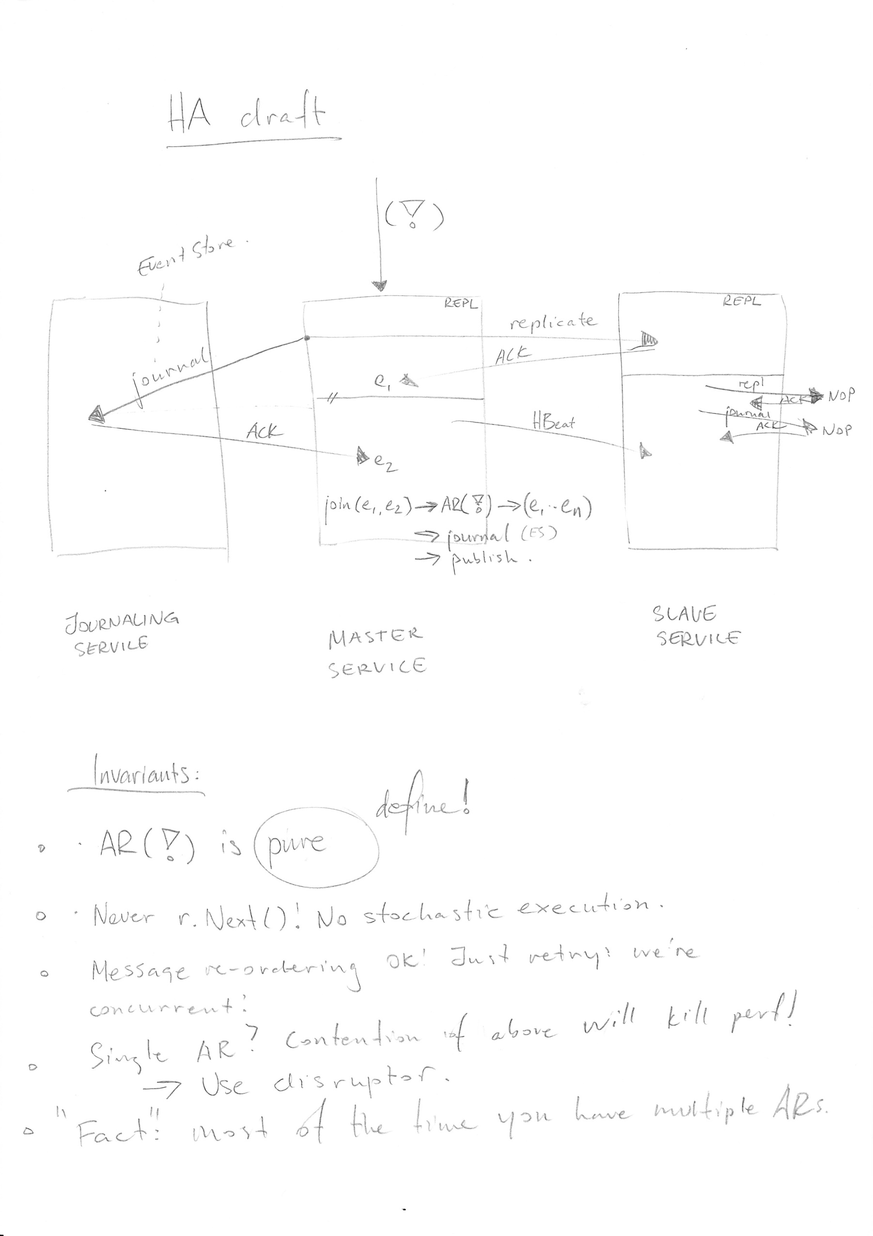
High Availability
Notes:
Master-Slave

Slide 50
Upsides

Slide 51
Failure after commit, before dispatch
Similarly, if the system fails between Dispatch and Dispatched = true,
publish twice;
Idempotence!
Notes:
Handlers need idempotence

Slide 52
A pure function
A pure function has no externally visible side effect.
f(x)_{s0} → s0
s0 = world state at time zero
Notes:
The function always evaluates the same result value given the same argument value(s). The function result value cannot depend on any hidden information or state that may change as program execution proceeds or between different executions of the program, nor can it depend on any external input from I/O devices.
Evaluation of the result does not cause any semantically observable side effect or output, such as mutation of mutable objects or output to I/O devices.
Now that we know what a pure method is; let’s look at some messaging [NEXT] concepts.
Lake: http://www.sxc.hu/photo/1343595

Slide 53
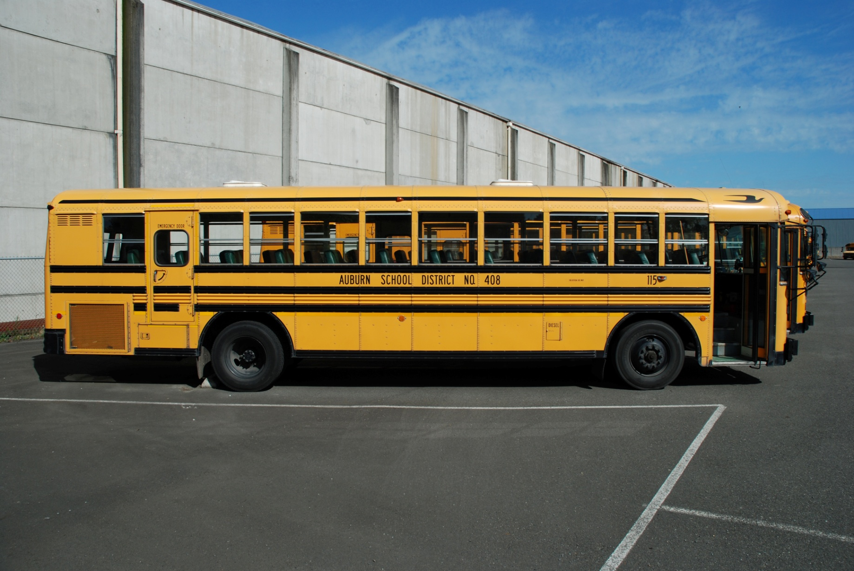
Do I need a Message Bus?
Notes:
...and in that case; which one?
Bus: http://www.sxc.hu/photo/1015488

Slide 54
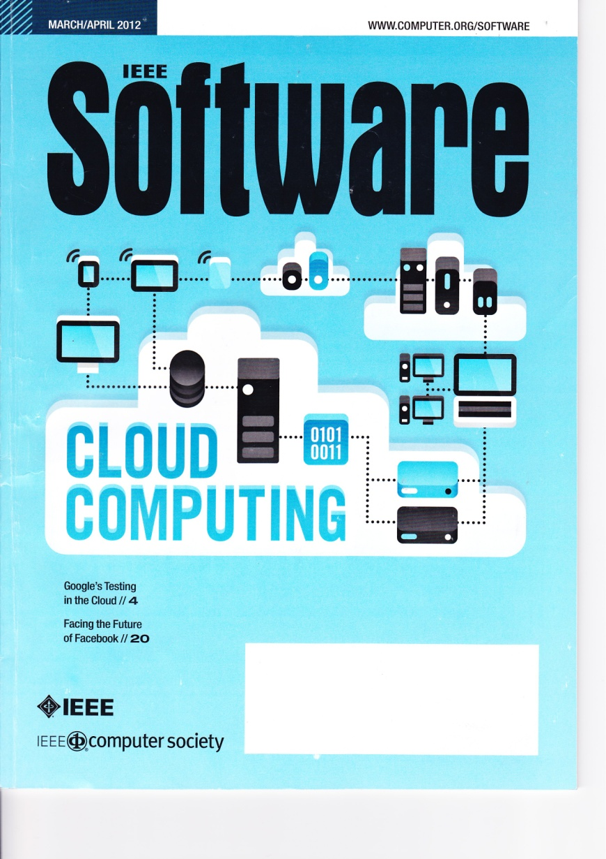
Occasionally Connected
Notes:
Customers are increasingly requiring integated experiences.
Instantaneous synchronization between work and home environments.
More clients connected to your service.
Push instead of pull
Occasionally connectedness!
Event Sourcing and CQRS is well positioned for this! You have seen [EDA, ES, events etc].
Now let’s have a look at how we can merge events in e.g. phones that have been offline for a while.

Slide 55
dm = new HandlerAndArPackage();
vm= new ViewModel();
offlineCommands = new List<Command>();
offlineCorrespEvts = new List<DomainEvent>();
void PerformOp() {
var cmd = new PerformOpCmd();
offlineCommands.Add(cmd);
var correspEvts = dm.CallWith(cmd);
offlineCorrespEvts.AddRange(correspEvts);
vm.RaiseRange(correspEvts);
}
void Handle(IEnumerable<DomainEvent> newEvents) {
foreach (var e1 in newEvents)
foreach (var e2 in offlineCorresp)
if (Conflicts(e1, e2))
NotifyGuiEditCommand(e2.FromCommand)
return;
dm.ApplyRange(newEvents.Concat(offlineCorrespEvts))
}
Merge Event Streams into Clients

Slide 56

Rebuilding Read Models
Notes:
Read Models are cheap; rebuild any time from event store.
Read Models help you move quicker, because they can be disposed of and rebuilt quicker. No more SQL migrations!
Rebuilt on deploy in 2 minutes instead!
Picture http://www.sxc.hu/photo/1258281 <- glasses

Slide 57

But Greg says I mustn’t use Frameworks!
Notes:
..that’s fine! We’re going to be using Libraries and the equivalent of a database – the event store!

